Slide 1
INTRODUCTION TO HYDROLOGIC STRUCTURES
G H PATEL COLLEGE OF ENGG. & TECH.(011), VALLBH VIDYANAGAR
PRESENTED BY
ARCHIT PATEL(130110105021)
BRIJESH PRAJAPATI(130110105039)
GUIDED BY
Dr. K PRIYAN &
PROF. SNEHAL POPLI

Slide 2
Dams
Dam is a solid barrier constructed at a suitable location across
a river valley to store flowing water.
A dam is a hydralic structure constructed acroos a river or a natural stream to store water on its up stream side.
Storage of water is utilized for following objectives:
Hydropower
Irrigation
Water for domestic consumption
For drought and flood control
Other additional utilization is to develop fisheries.

Slide 3
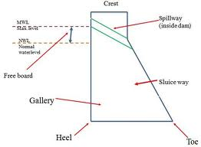
Structure of dam

Slide 4
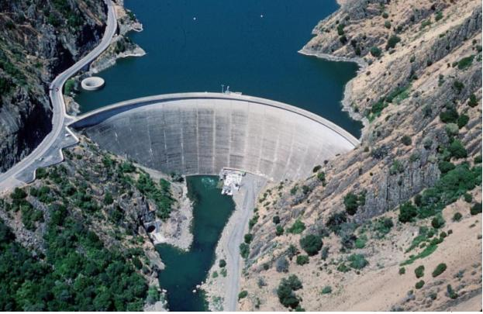
Arch Dam
This type of dams are concrete dams which are curved or convex upstream in plan
This shape helps to transmits the major part of the worlds loads to the abutments
Arch dams are built across narrow deep river gorges But now in recent years they have been considered even for little wider valleys.

Slide 5
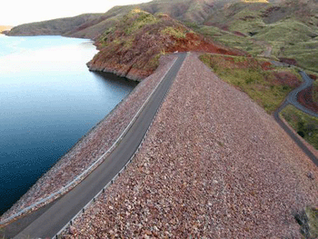
Earth dam
Earth dams are trapezoidal in shape
Earth dams are constructed where the foundation rocks are weak to support
Earth dams are relatively smaller in height and broad at the base
They are mainly built with clay , sand and gravel. hence they are also known as Earth Fill dam or Rock Fill dam

Slide 6
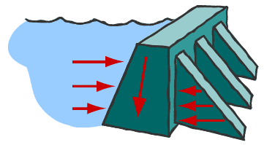
Buttress Dam
Buttress Dam - Is a gravity dam reinforced by structural supports
Buttress Dam –A support that transmits a force from a roof or wall to another supporting structure
This type of structure can be considered even if the foundation rocks are little weaker

Slide 7
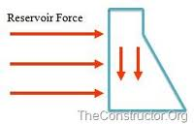
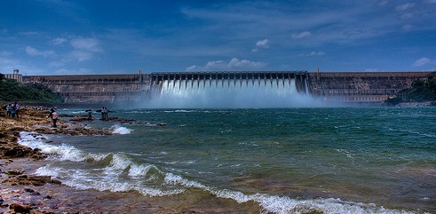
Gravity Dam
These dams are heavy and massive wall-like structure of concrete in which the whole weight acts vertically downwards

Slide 8
CHECK DAM
A check dam is a small, temporary or permanent dam constructed across a drainage ditch, swale, or channel to lower the speed of concentrated flows for a certain design range of storm events.
Check dams reduce the effective slope of the channel, thereby reducing the velocity of flowing water, allowing sediment to settle and reducing erosion

Slide 9
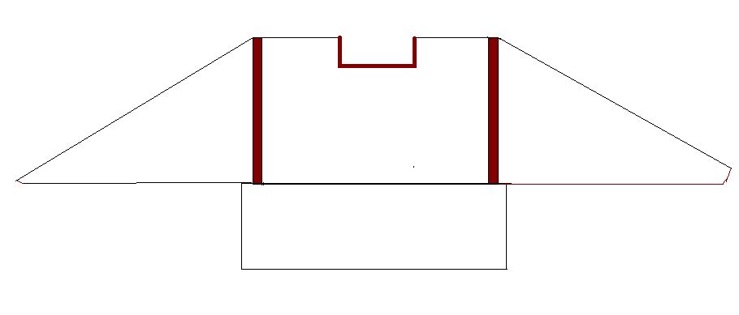
CHECK DAM
SPILL WAYS
WING WALLS
BODY
WING WALLS
APRON

Slide 10
CHECK DAMS MAY BE APPROPRIATE IN THE FOLLOWING SITUATIONS:
To promote sedimentation behind the dam.
To prevent erosion by reducing the velocity of channel flow
In small intermittent channels and temporary swales.
In small open channels that drain 10 acres or less.

Slide 11
In steep channels where storm water runoff velocities exceed 5 ft/s.
During the establishment of grass linings in drainage ditches or channels.
In temporary ditches where the short length of service does not warrant establishment of erosion-resistant linings.

Slide 12
BARRAGES
A barrages is a type of low head,diversion dam which consist of a number of large gates that can be opened or closed to control the amount of water passing threw the structure, and thus regulate and stabilize river water in the up stream for use in irrigation and other systems.

Slide 13
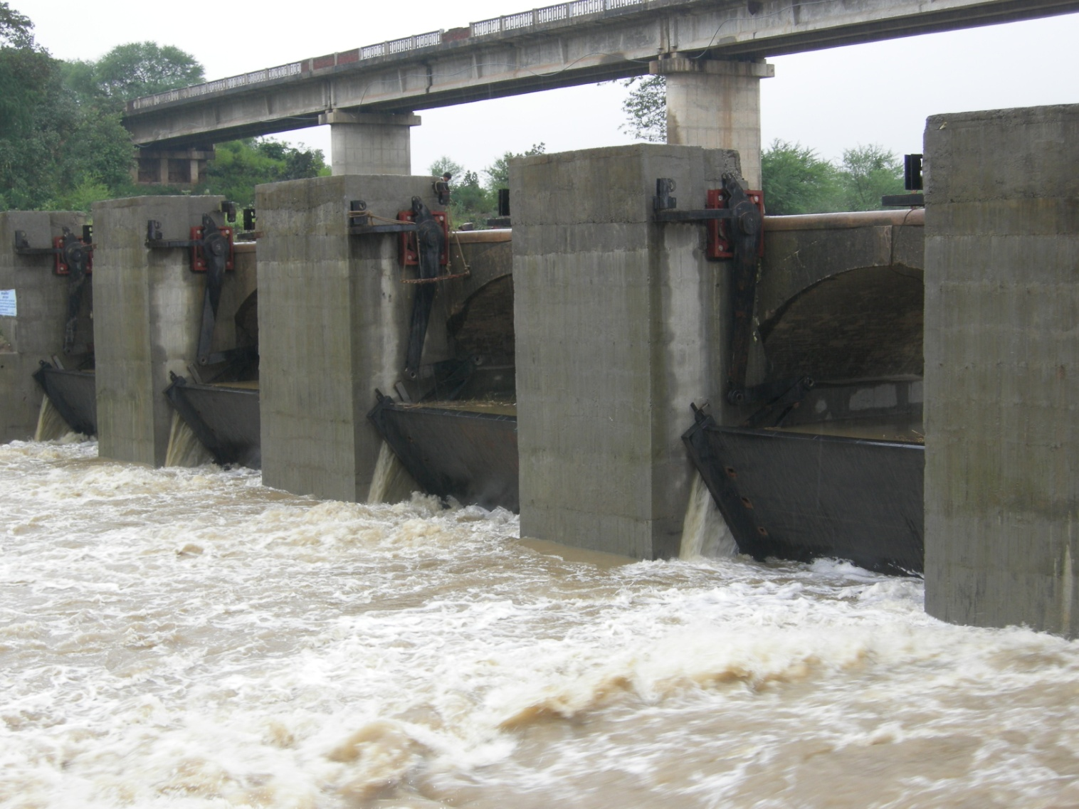
Barrages

Slide 14
Weir
A weir is a barrier across a river designed to alter its flow characteristics.
The weir is solid obstruction put across the river to raise its water level and divert the water into the canal.

Slide 15
THANK YOU

